Slide 1
Simple ASP.NET Core app
Deployment in Azure Cloud
By Vitaliy Savluk & Denys Shamygin
DP-157 DevOps

Slide 2
AGENDA
SUMMARY
TECHNOLOGY STACK
ENVIRONMENT DIAGRAM
DEPLOYMENT VIEW
TASK DECOMPOSITION
QUESTIONS
REFERENCES

Slide 3
SUMMARY
Goals:
Prepare fully automated solution to deploy of Book store application (created using ASP.NET MVC) to the MS Azure. As a CI service Azure DevOps is used and as a PaaS cloud provider MS Azure AppService is used.
Deployment environment consist of web application instance of Azure AppService and SQL DB and instance of Azure SQL. There are to slots inside Azure AppService with Web App (Staging and Production).

Slide 4
TECHNOLOGY STACK
Development tools:
MS Visual Studio 2017
ASP.NET Core MVC Framework with Entity Framework Core 2.1.1
CI/CD service :
Azure DevOps Pipelines
Deployment service :
Azure AppServices;
Azure SQL

Slide 5
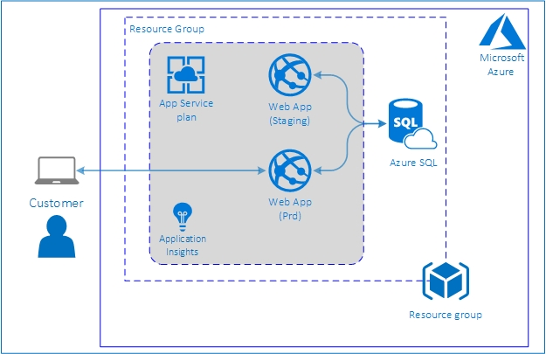
ENVIRONMENT DIAGRAM
Azure Cloud Services:
Azure AppService (Web App)
Azure Insights
Azure SQL

Slide 6
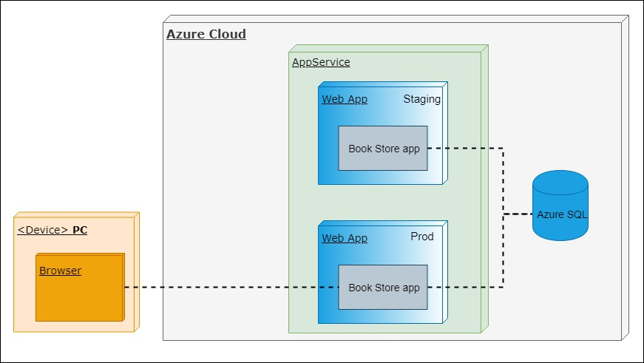
DEPLOYMENT VIEW

Slide 7
TASK DECOMPOSITION
Developing:
Application developing
Database creation
Deployment:
Create ARM templates
Create Azure DevOps Pipelines
Create environments in Azure Cloud
Documentation:
Prepare DevOps Solution Assessment;
Prepare presentation
Complete repository Readme.md

Slide 8
QUESTIONS?

Slide 9
REFERENCES
Project’s repository: https://github.com/vitalidn/DP157.Team1.Demo3
Web application site: https://minimoobookstore.azurewebsites.net

